Slide 1
Employee Data Analysis using Excel
STUDENT NAME:Shanmughavel M
REGISTER NO: (autumn110312201283) 312201283
8044B2BE1433EEDB40B4FA08E7DBD991
DEPARTMENT: B. Com general
COLLEGE: DRBCCC HINDU college

Slide 2
PROJECT TITLE
Employee Performance Analysis using Excel

Slide 3


AGENDA
Problem Statement
Project Overview
End Users
Our Solution and Proposition
Dataset Description
Modelling Approach
Results and Discussion
Conclusion
3/21/2024 Annual Review

Slide 4

PROBLEM STATEMENT
Problem Statement: This section likely introduces a specific issue or challenge related to employee performance that the project aims to address.
This section introduces the specific issue or challenge related to employee performance that the project aims to address. The problem could involve inefficiencies, performance gaps, or other aspects of employee performance that require analysis.

Slide 5

PROJECT OVERVIEW
The project focuses on analyzing employee performance data using Excel tools to identify trends, strengths, and areas needing improvement. The analysis is designed to be user-friendly, leveraging Excel’s capabilities to ensure that HR managers and business leaders can make informed decisions based on the data.

Slide 6

WHO ARE THE END USERS?
These could be used by HR managers, department heads, or other stakeholders who need insights from the employee performance data.

Slide 7

OUR SOLUTION AND ITS VALUE PROPOSITION
The solution involves a structured analysis of employee performance data using Excel's powerful data manipulation and visualization tools. The key steps in this solution include:
Data Collection and Preparation:
Collecting Data: Gather employee performance data, including metrics like performance ratings, job titles, departments, and other relevant factors
Data Analysis with PivotTables:
Summarization: Use PivotTables to summarize performance data by various categories, such as departments, job titles, or specific performance levels. This allows for quick insights into how different groups of employees are performing.

Slide 8
Visualization with Pie Charts:
Creating Pie Charts: Generate pie charts to visually represent the proportion of employees in each performance category. This helps in quickly identifying areas of strength or concern.
Value Proposition:
The value proposition for this solution is centered around its ability to provide actionable insights and drive data-driven decisions in managing employee performance
Data-Driven Insights: By summarizing and visualizing employee performance data, managers can make informed decisions regarding promotions, training needs, or resource allocation.
Quick Identification of Issues: The use of pie charts and PivotTables allows for quick identification of performance issues, enabling timely interventions to improve overall productivity.

Slide 9
Dataset Description
Employee Data set :Kaggle
Employee Id:Numerical
Employee name :text
Company name:text
Employee rating :numerical
Performance level :text

Slide 10

THE "WOW" IN OUR SOLUTION
The formula used in the solution is
=IFS(Z8>=5,“VERY HIGH”,Z8>=4,“HIGH ”,Z8>=3,“MED”,“TRUE”,“LOW”)
3/21/2024 Annual Review
10

Slide 11
MODELLING
Pivot table : In your file, the PivotTable would have been used to categorize employee performance data by titles, departments, or other criteria. The table you mentioned likely results from grouping this data to show counts of employees in each performance category (e.g., HIGH, LOW, MED, VERY HIGH).
Pie chart : The pie chart would be created from the summarized data in the PivotTable to visually display the distribution of employee performance levels. Excel allows users to easily create pie charts by selecting the relevant data and choosing the pie chart option from the chart types.
Data Filtering : If there were many rows of data, filtering might have been used to isolate specific performance levels or departments to better analyze those segments
11

Slide 12
Modeling
Formulas and function : In summarizing the data for the PivotTable, functions might have been used to count the number of occurrences of each performance level or to calculate averages and totals.
Conditional formatting : Conditional formatting could be used to color-code cells based on performance ratings, making it easier to spot trends (e.g., highlighting low-performing departments in red).

Slide 13
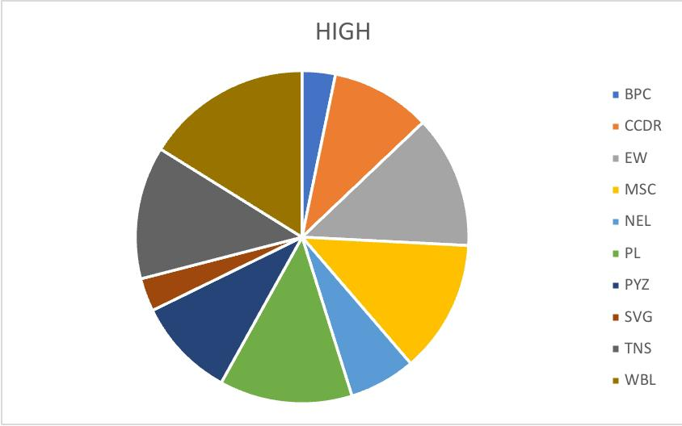
RESULTS
13

Slide 14
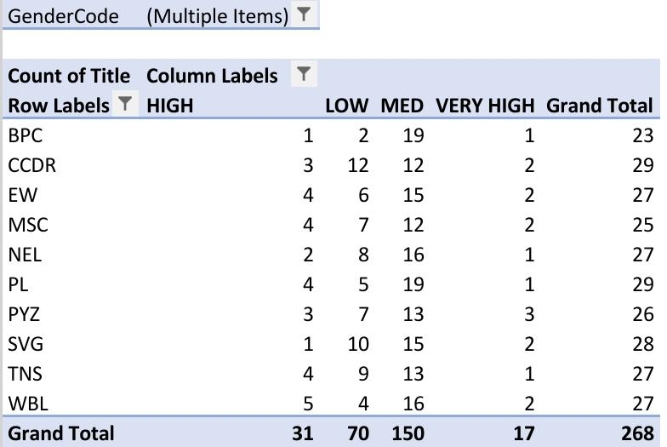
Results

Slide 15
conclusion
The project effectively demonstrates the power of leveraging Excel for comprehensive employee performance analysis. By using tools like PivotTables and pie charts, the project provides a clear, data-driven understanding of how employees are performing across various roles and departments.

